Slide 1
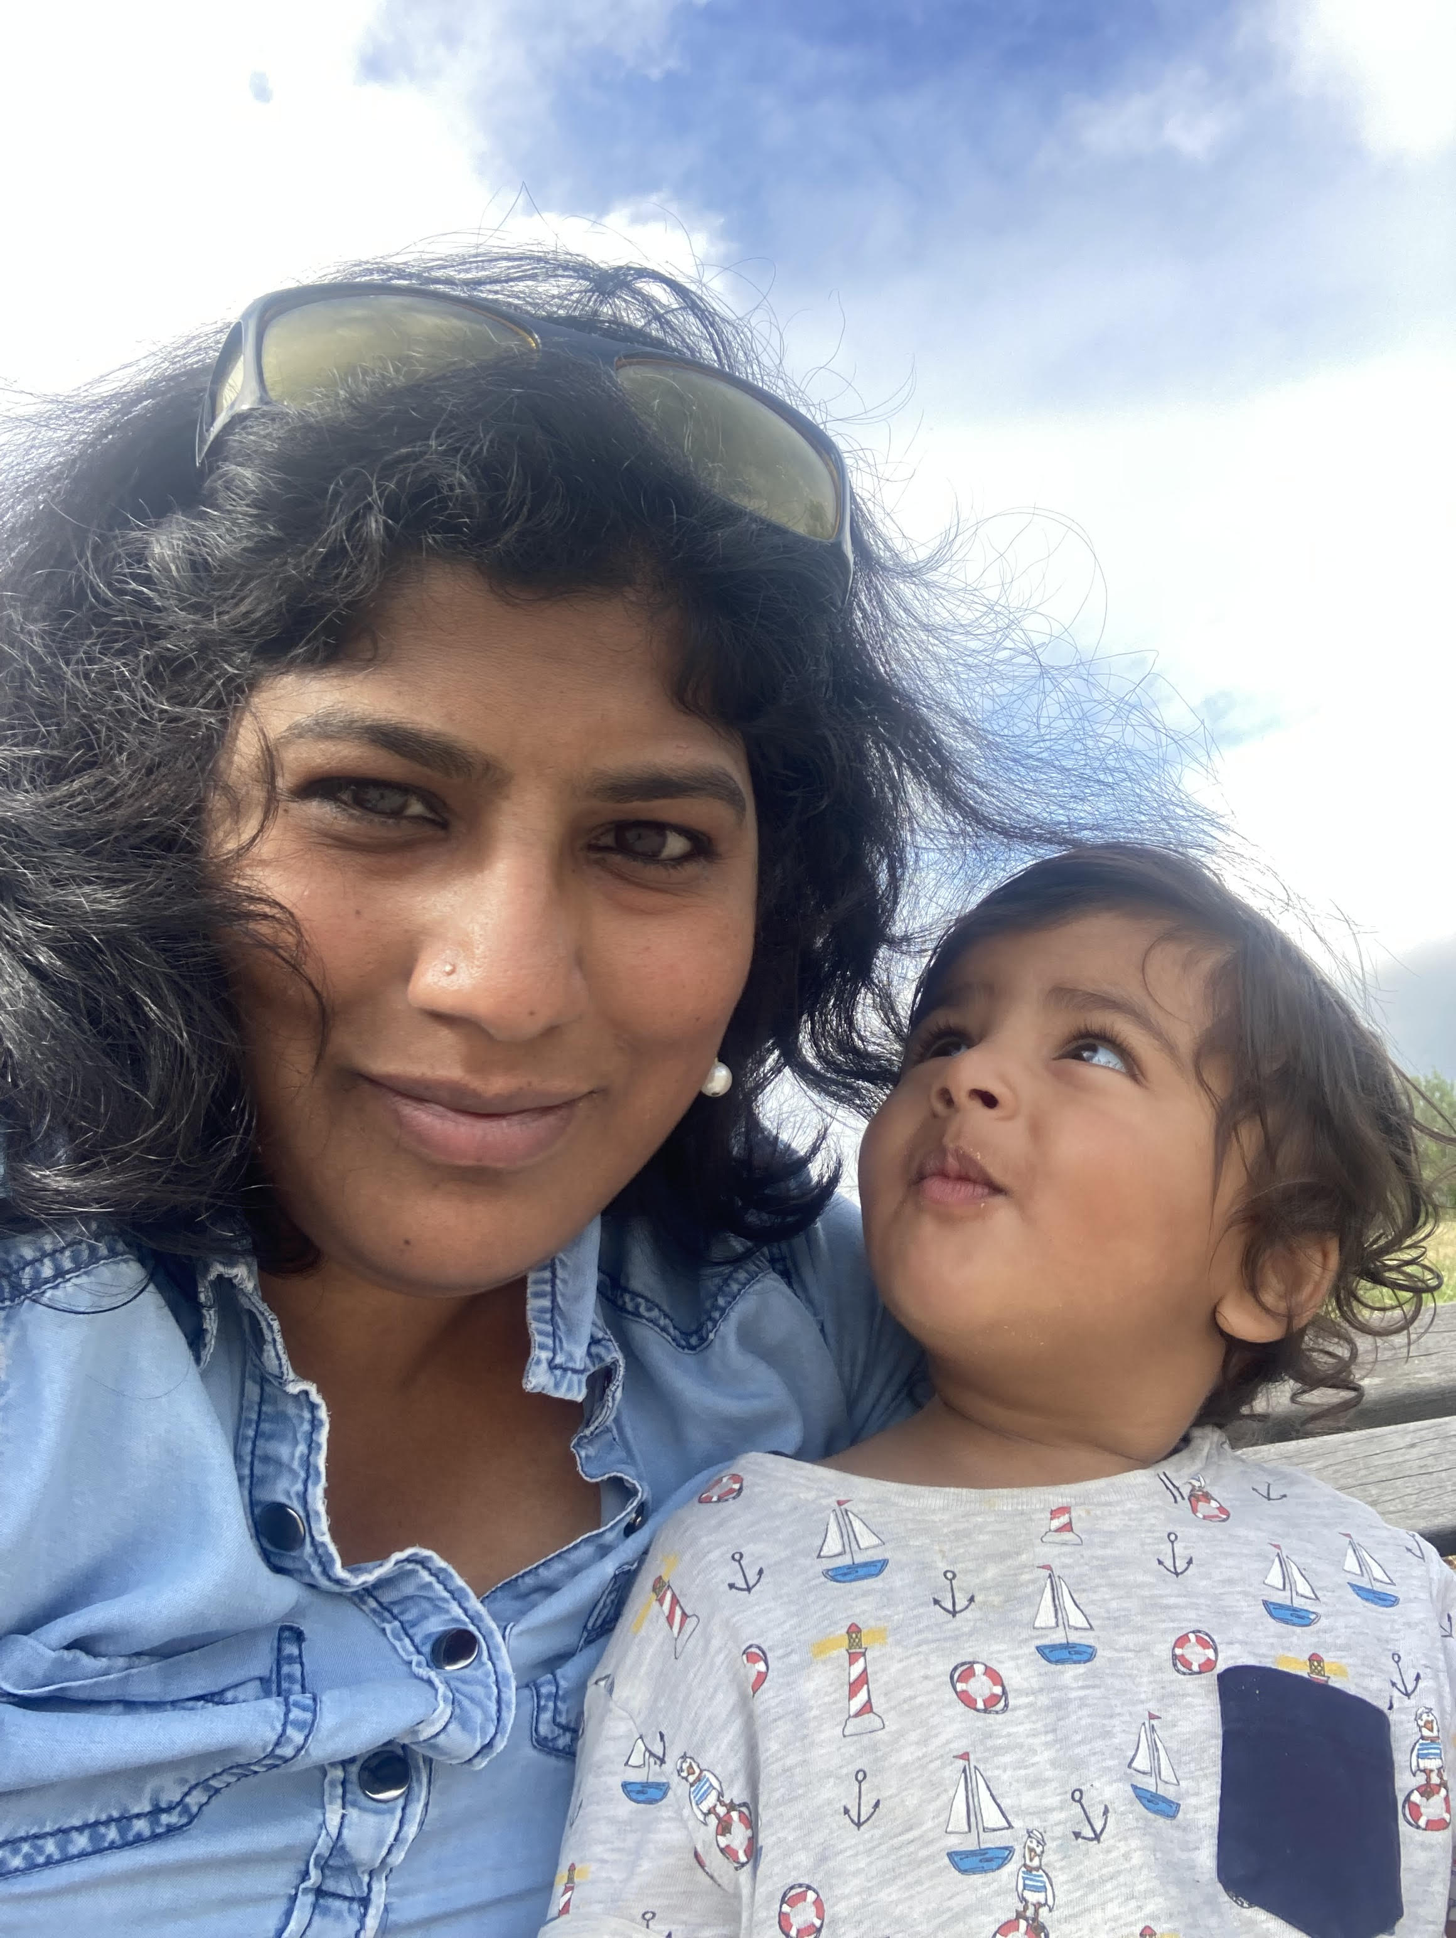
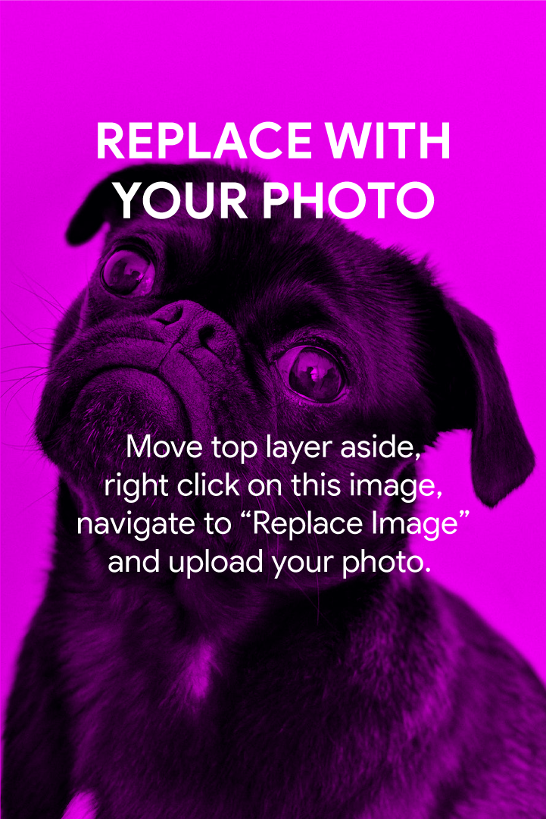
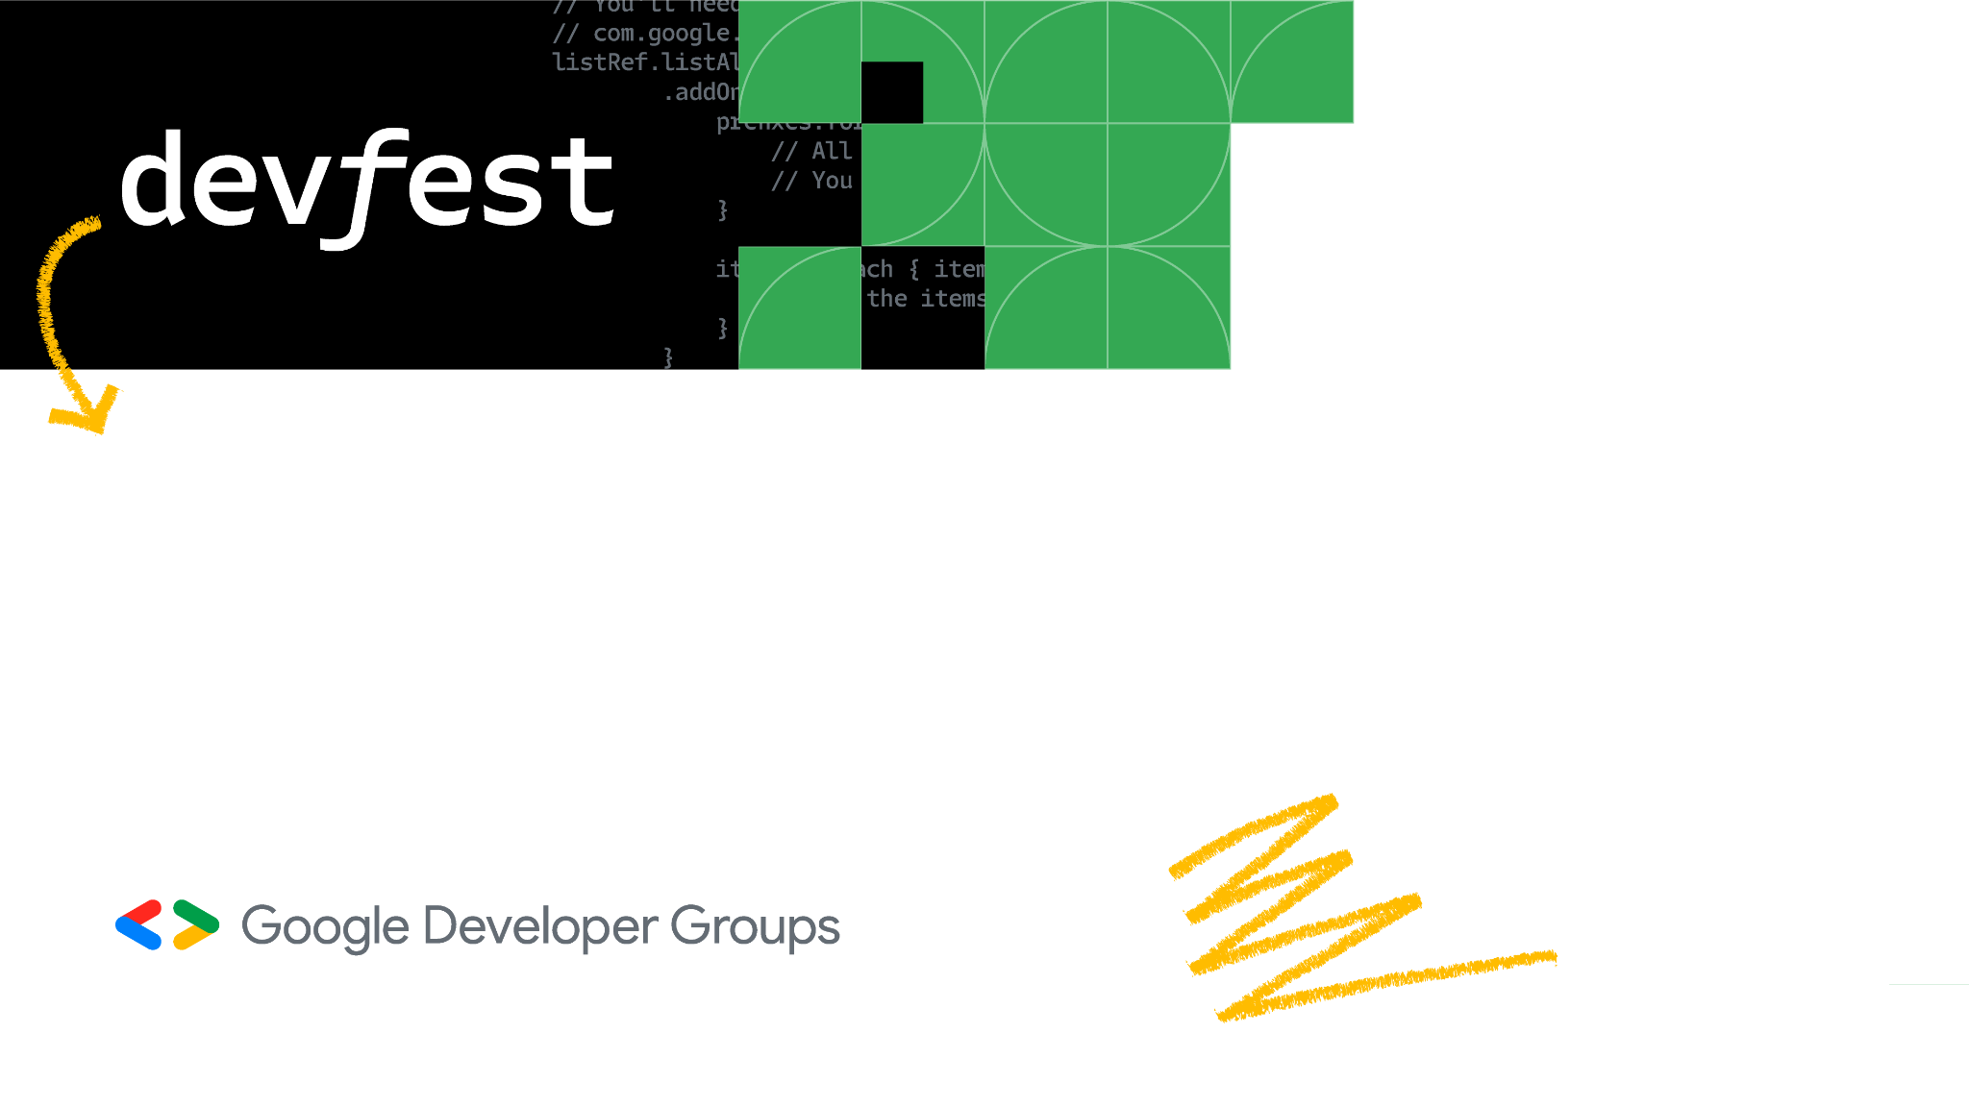
Designing for Neurodiversity, Empathy, Human Centric Design and Inclusion in Software Applications
Vancouver

Slide 2

Glossophobia

Slide 3
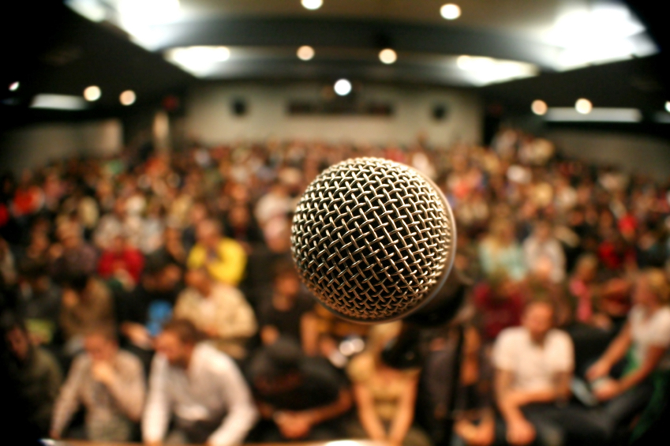

Slide 4
This is an example of section title slide
Editable Location

Slide 5
What is Neurodiversity? Accessibility vs ND Guidelines for Design Concluding Remarks
Agenda

Slide 6
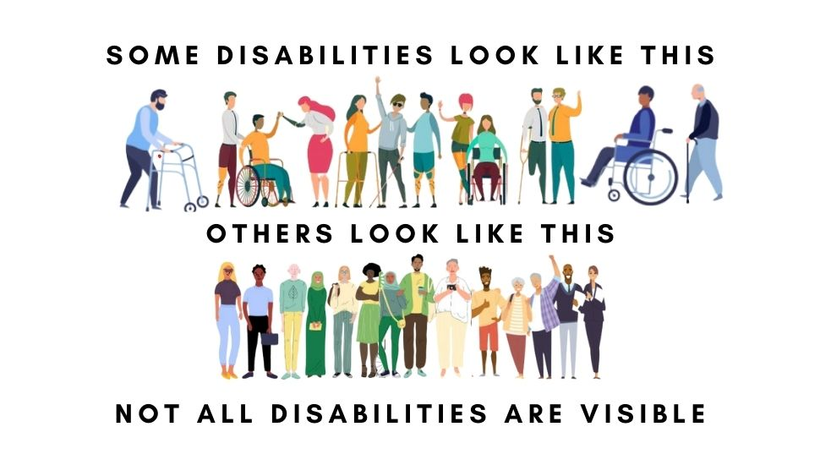

Slide 7
Neurodivergent brains are biologically different. One cannot be "trained out of" the way their brain works

Slide 8
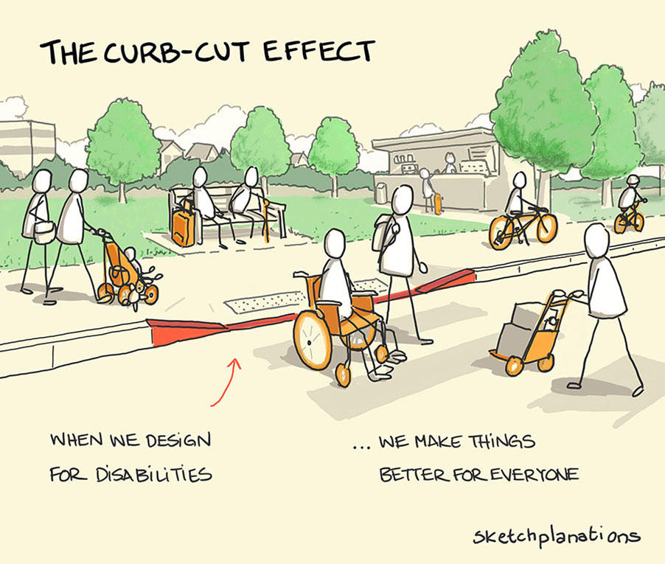
Notes:
Named after the curb cut that enables wheelchair users on and off

Slide 9
Not legally required until 1990 with the signing of Americans with Disabilities Act.

Slide 10
Solve for one, extend to many
Notes:
Everyone has abilities and limits.
Everyone has abilities and limits.
Creating products for people with permanent disabilities creates results that benefit everyone.
Creating products for people with permanent disabilities creates results that benefit everyone.

Slide 11
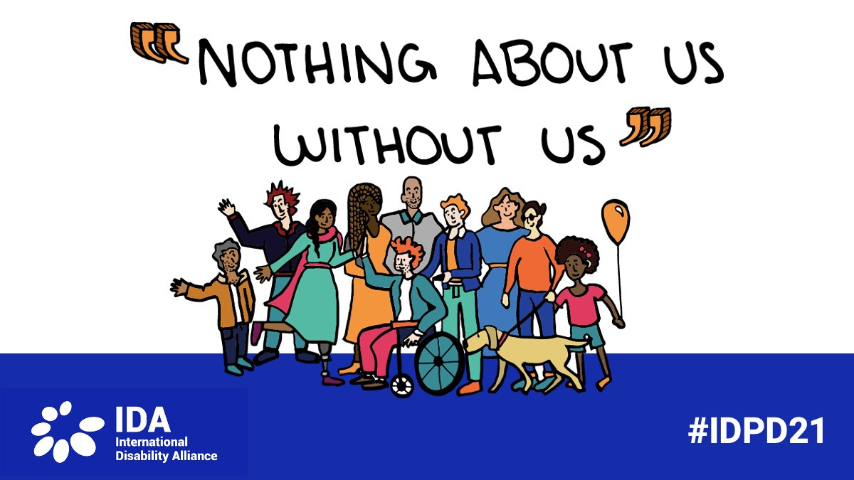

Slide 12
Risk marginalization and only cater to the central, normal values as peak users in the Gaussian(bell) curve.
Notes:
Everyone has abilities and limits.
Creating products for people with permanent disabilities creates results that benefit everyone.

Slide 13
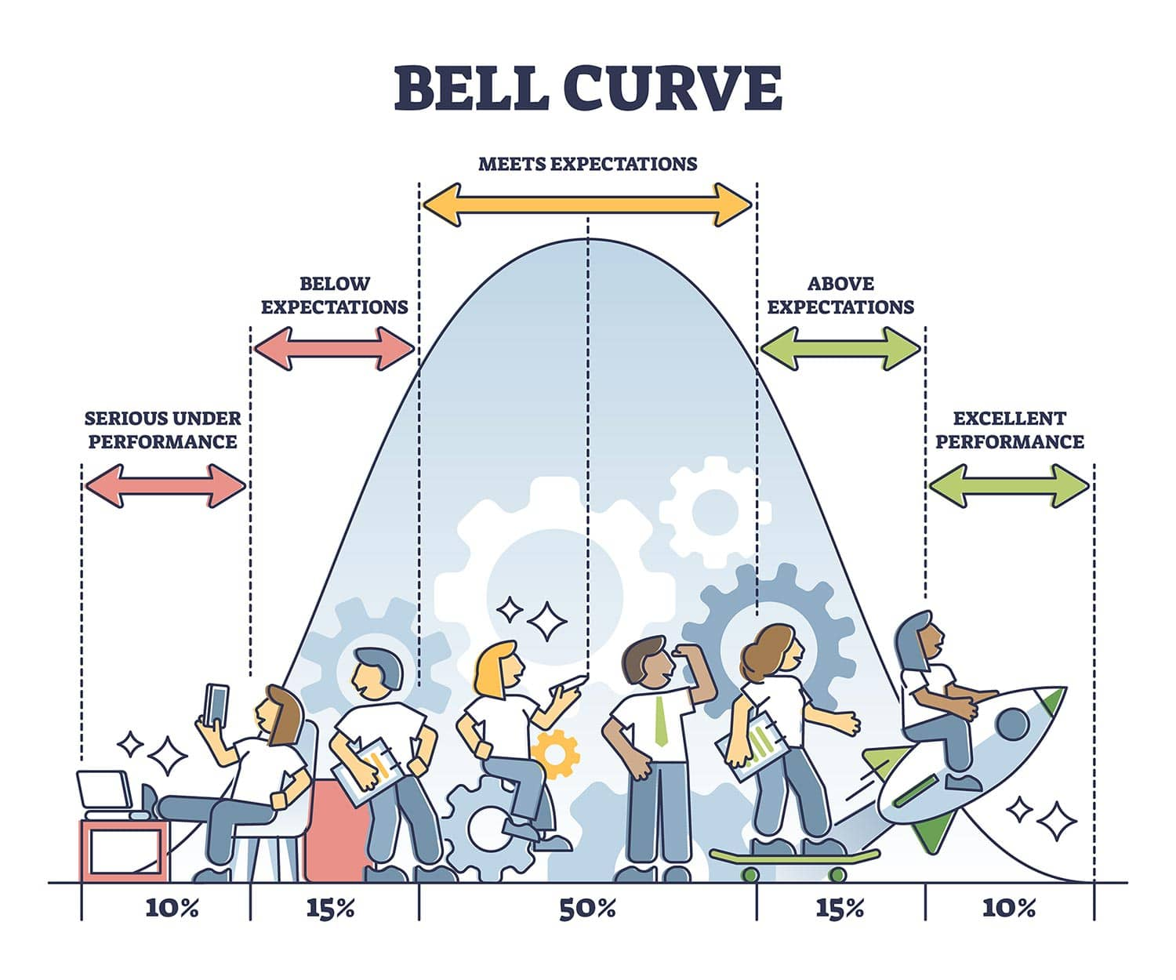
Source : https://www.simplypsychology.org/normal-distribution.html

Slide 14
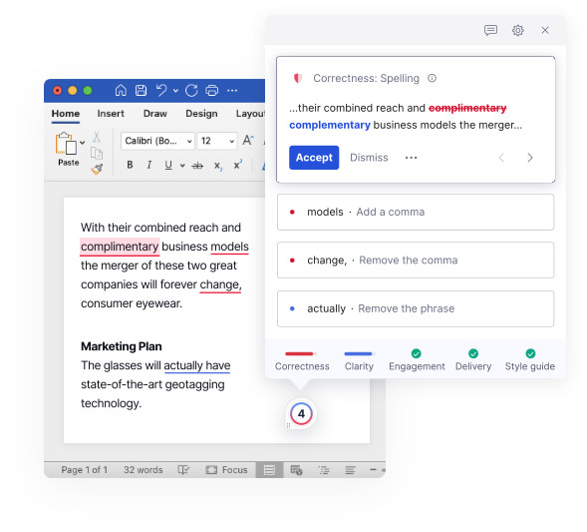
Be Kind and Forgiving Grammarly - Disneyland of Spelling

Slide 15
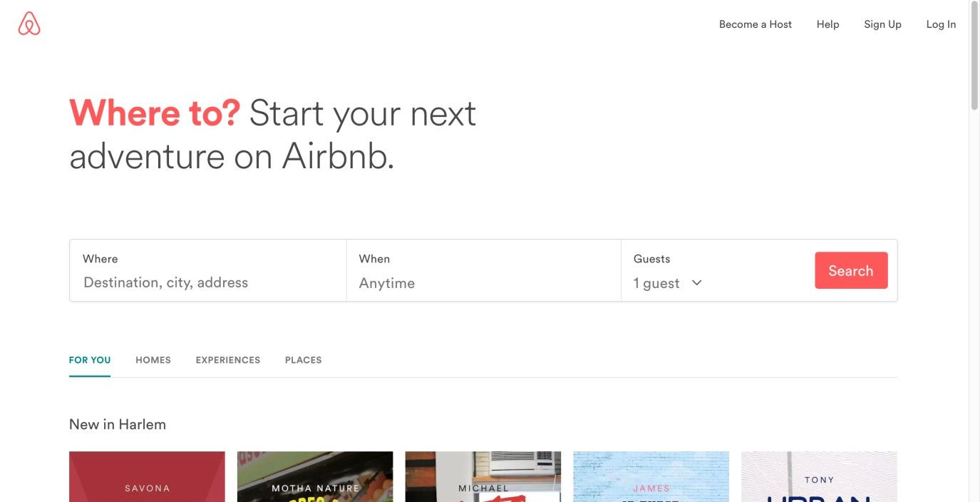
Implement a Forgiving Format to Accommodate Users’ Mistakes
“We don’t make mistakes, just happy little accidents.” —Bob Ross, American painter, painting instructor, and TV show host
Notes:
do not want to punish them for their irregularities and force them to correct things before providing them with the expected or desired responses. They’re users who are visiting your site by choice, not your students or employees.

Slide 16
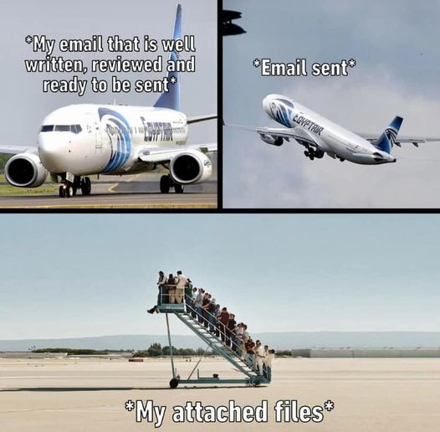
Forgot attachment?
Attachments first, message second, subject third, and recipients last. This is my way.
Notes:
Attachments first, message second, subject third, and recipients last. This is the way.

Slide 17
Abundance and not redundance
Editable Location

Slide 18
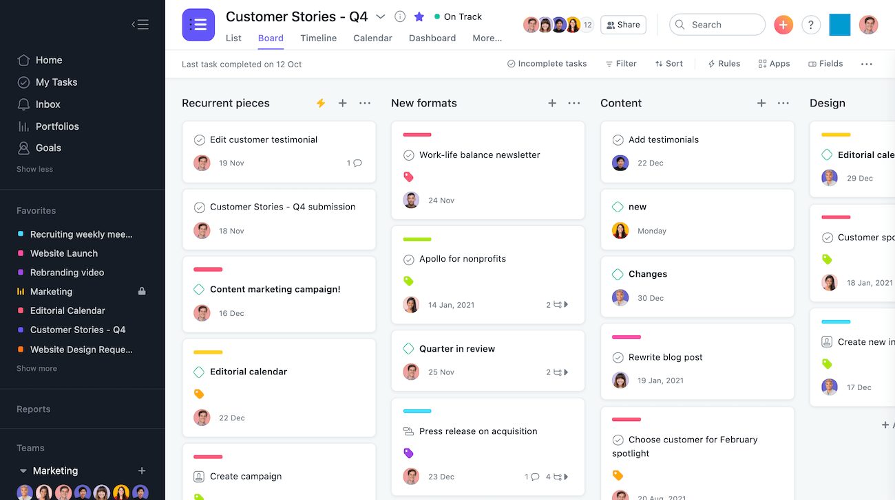
Notes:
For any Asana project, you can switch between several different views to see tasks however you want: Lists - For chronological to-dos. Boards - Kanban style view to move work through stages. Timeline - Gantt-style view for deadline-bound work with dependencies.

Slide 19
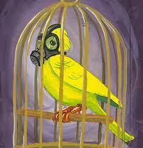
Canary in the coalmine

Slide 20
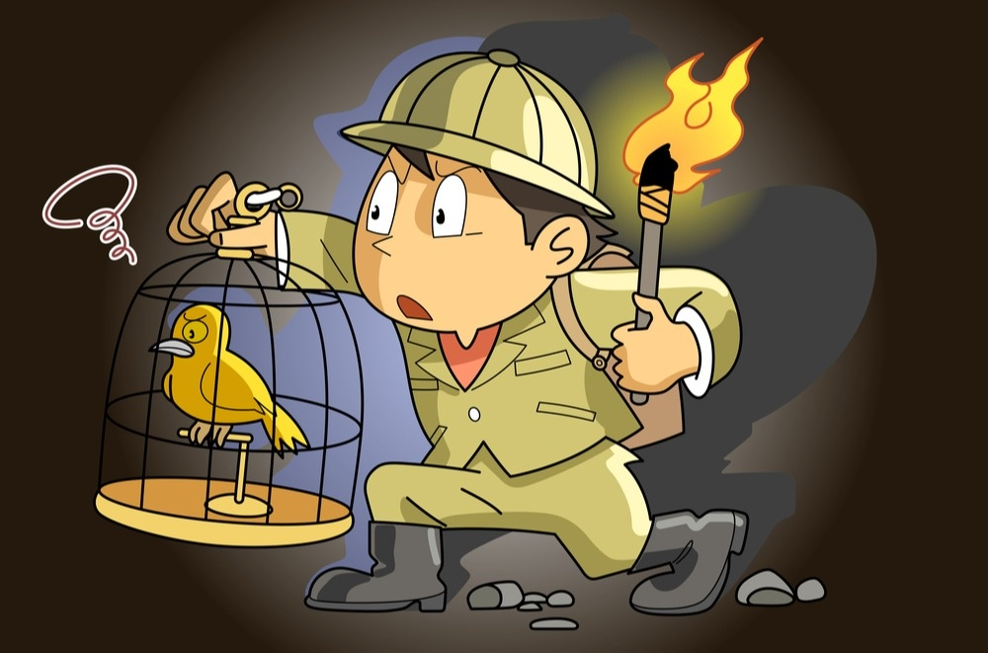
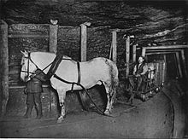
Often the first to sense danger akin to canaries in the coal mine Preventing miscommunication and not overwhelming the users
Notes:
Coal miners used to take canaries into coal mines with them. Canaries are more sensitive to dangerous gases than humans are. If the canary died, the miners knew there were dangerous gases present and would leave the mine.
Pit ponies, the other animal that went underground with human miners to haul coal, were also phased out by automation. T

Slide 21
Guidelines

Slide 22
Guidelines
Interpretable messages
Avoid use of characters that look alike
E.g. 1lI, B8, QO0CD, and break up long strings in phone numbers e.g. (000) 000–0000
Stick to active voice : Passive voice sentences are longer and harder to comprehend. Users with ADHD will get bored, dyslexics will have even more trouble reading, and so will readers on the spectrum.
Avoid metaphors : Trouble understanding metaphors, such as idioms and other abstract figures of speech.
E.g. Instead of calling it a day, it’s more inclusive to say that something is done.

Slide 23
Guidelines
Format your writing : Divide large chunks of text into smaller paragraphs.
It is challenging for people struggling with limited attention spans.
Use descriptive buttons : No vague microcopy, such as Click here.
Describe the purpose of the button.
Example: Upload images, Register, Download the e-book.
This simple change makes navigation smoother and reduces anxiety.
Be careful with animations : Too much stimulation can induce anxiety in people on the autism spectrum, which may even lead to physical pain, withdrawal, or meltdown.
Use of animated elements : should be limited to instances when it serves a purpose.
Also remember not to make them too invasive.

Slide 24
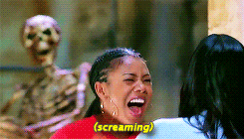
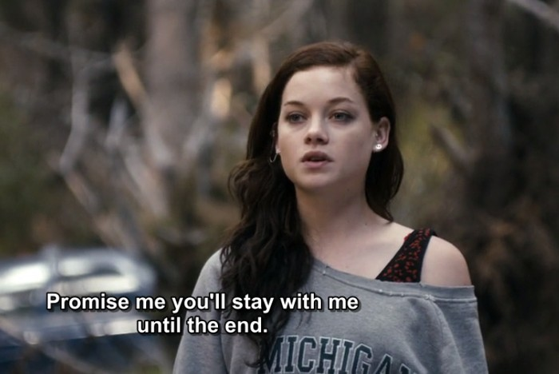
Avoid autoplay Unexpected movement is surprising and scary, not to mention the sound! Add subtitles and captions Bring in the perspective of ND users Perform user testing and focus groups with them.

Slide 25
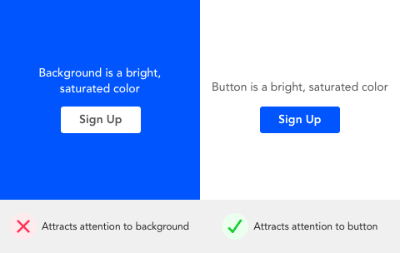
Aim to visually please, rather than disturb. Abstain from auto play in websites and music that suddenly appears out of nowhere. Skip highly vibrant colors.

Slide 26
Takeaways
Aim to visually please, rather than disturb.
Abstain from auto play and music that suddenly appears out of nowhere.
Skip highly vibrant colors.

Slide 27
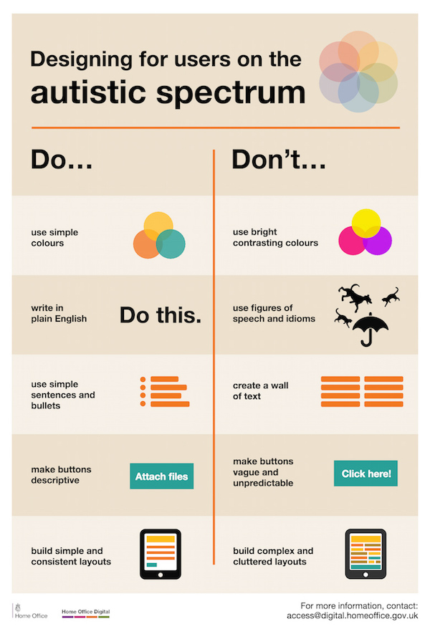

Slide 28
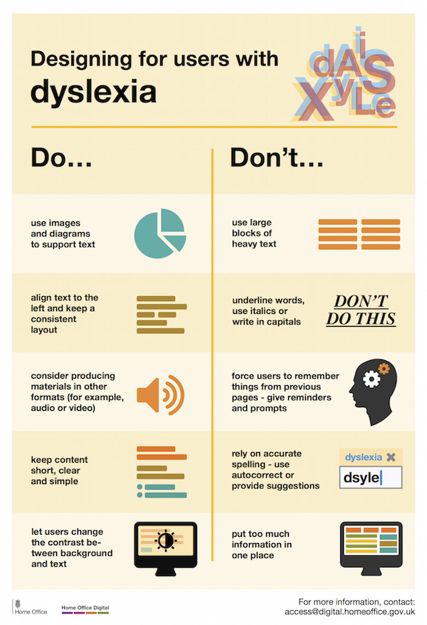

Slide 29
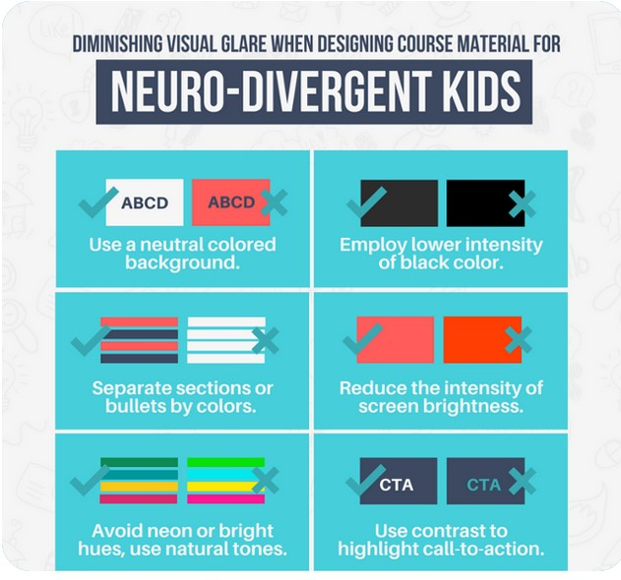
Credit : DesignMantic

Slide 30

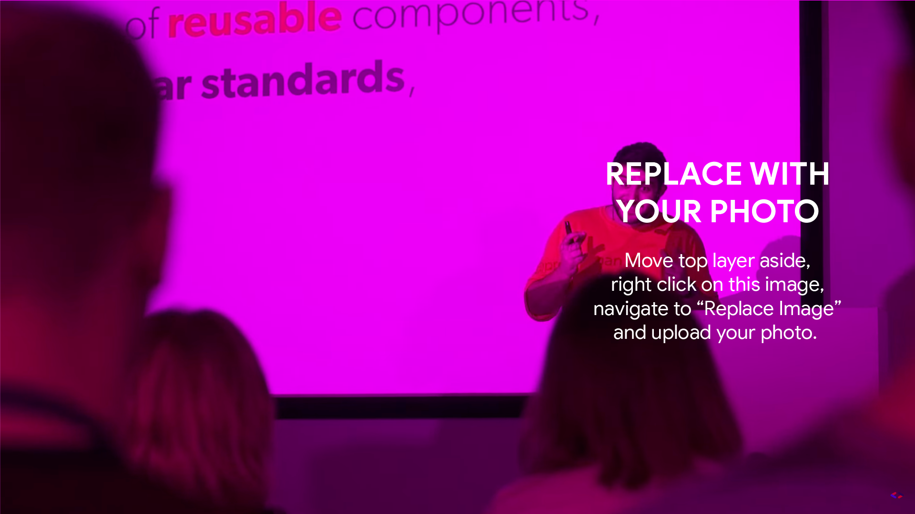
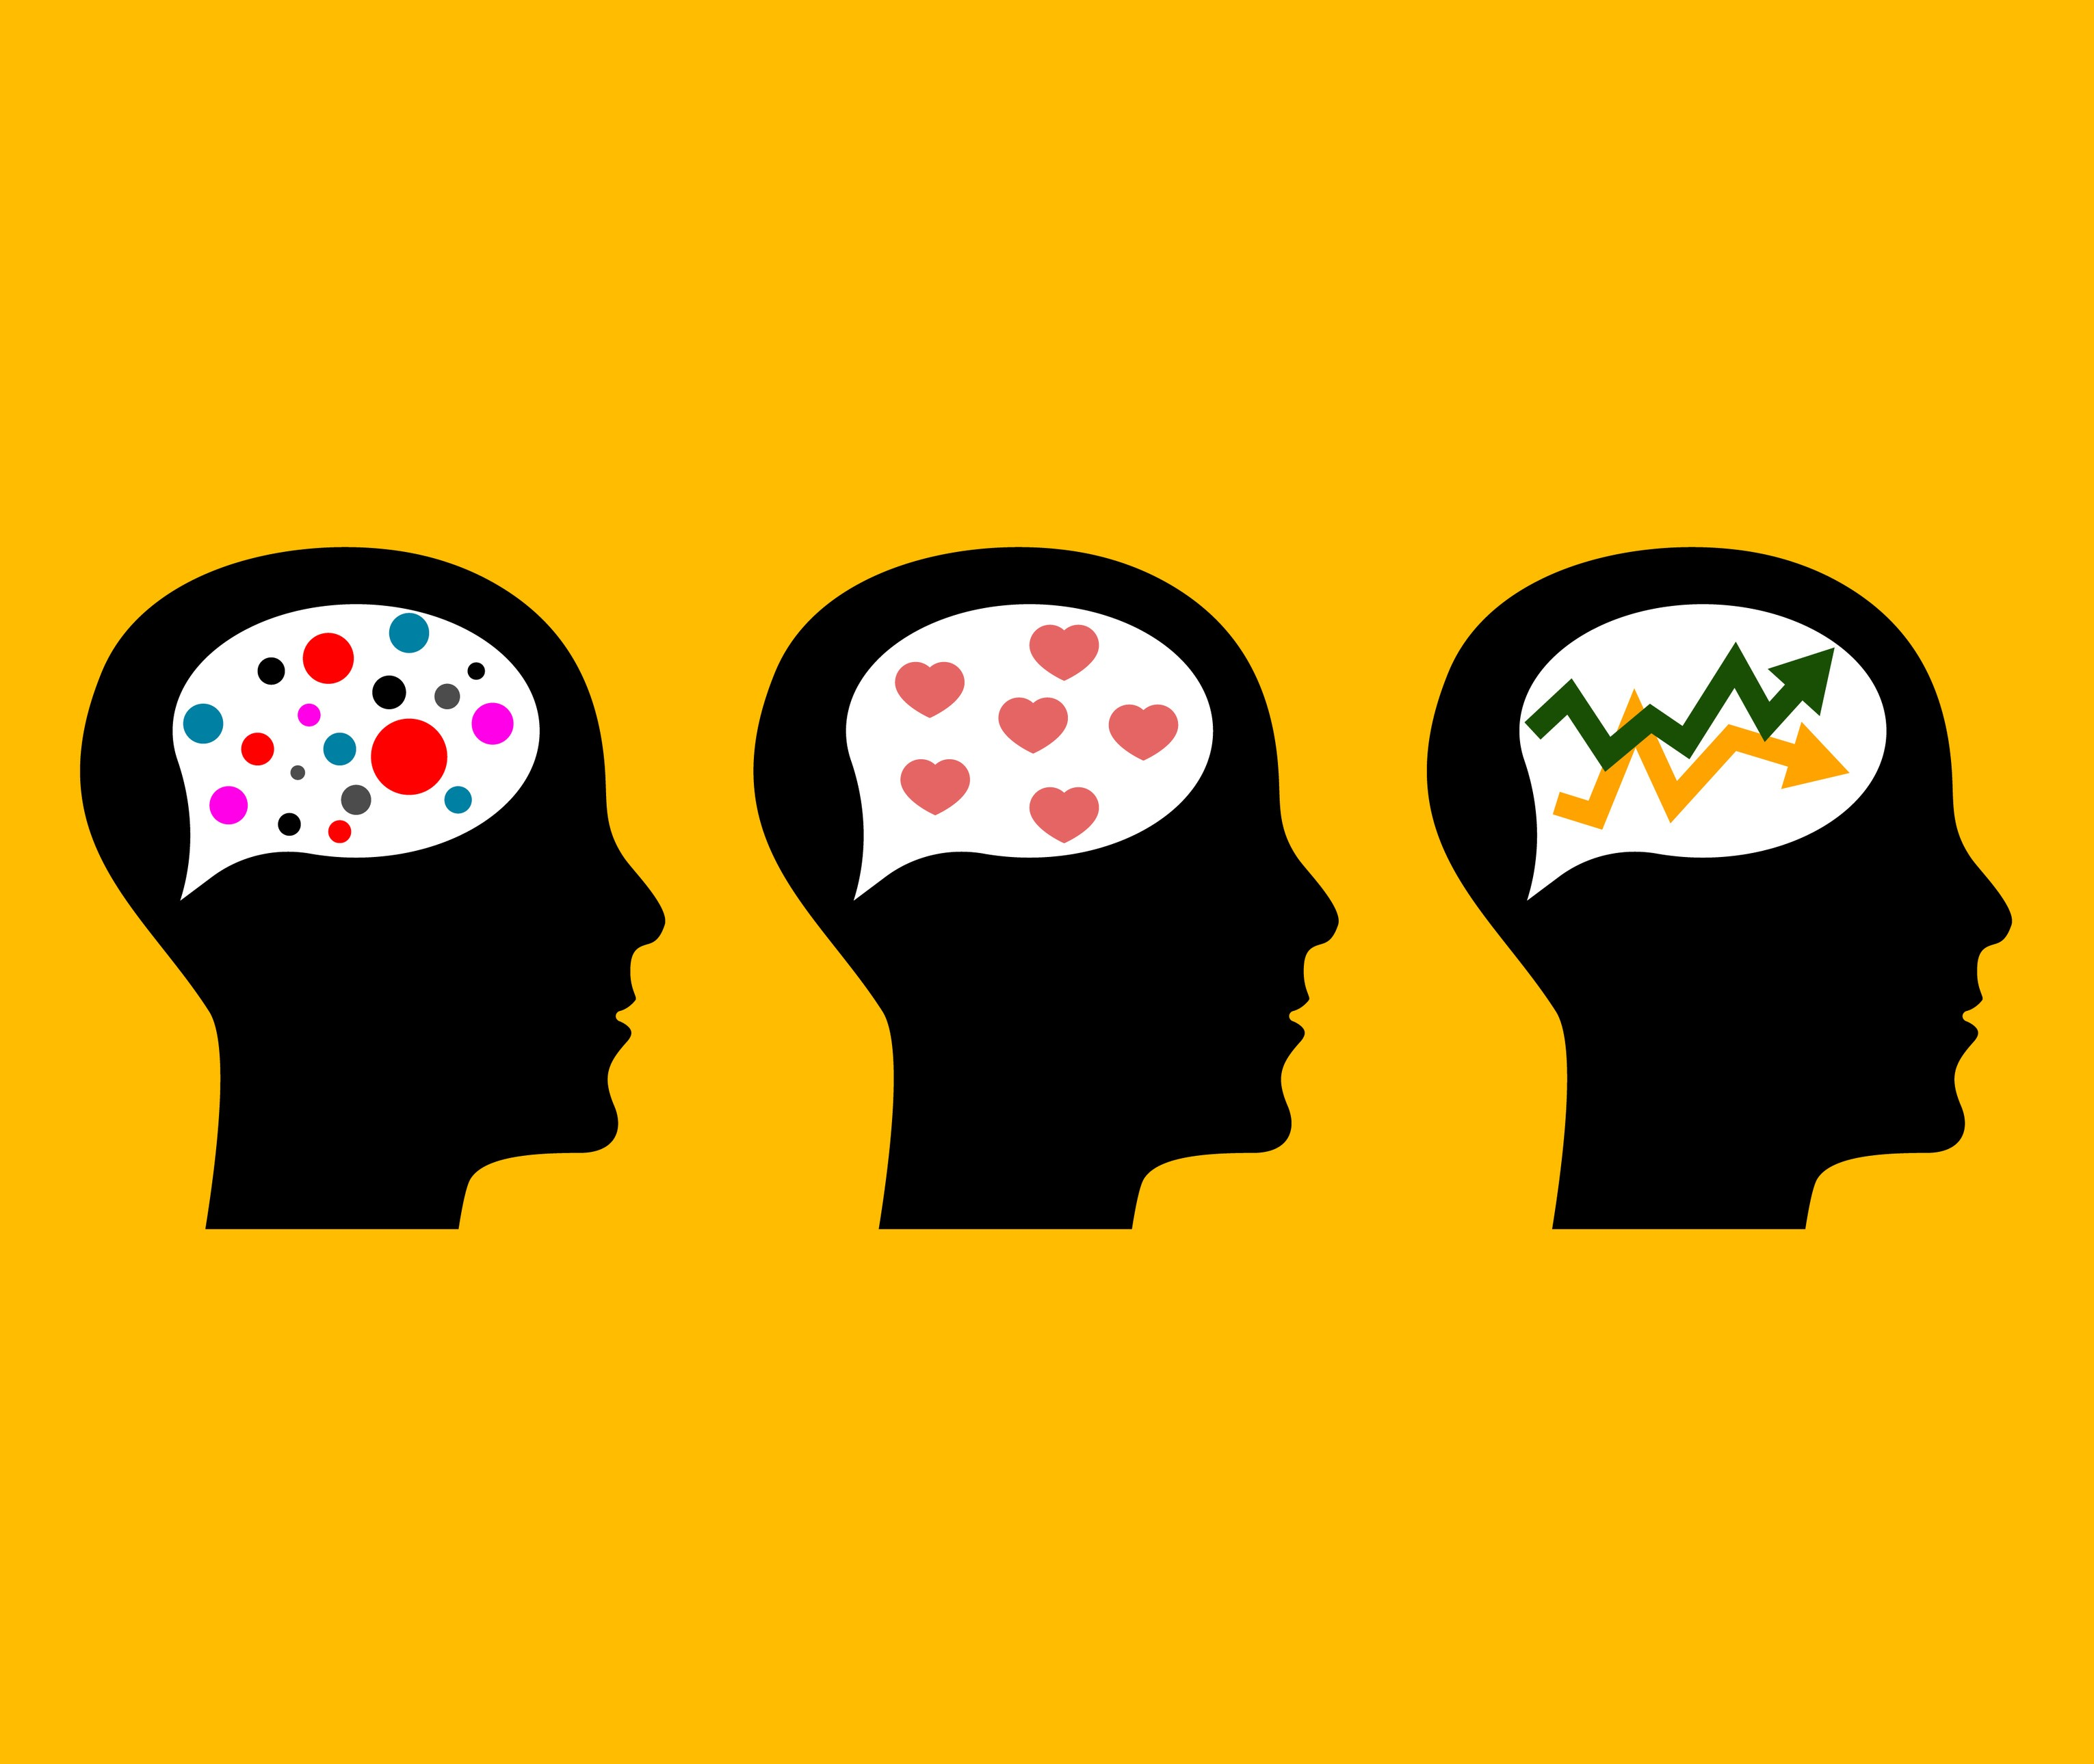

Great Minds Think Unalike And Learn Differently Representation Matters!

Slide 31
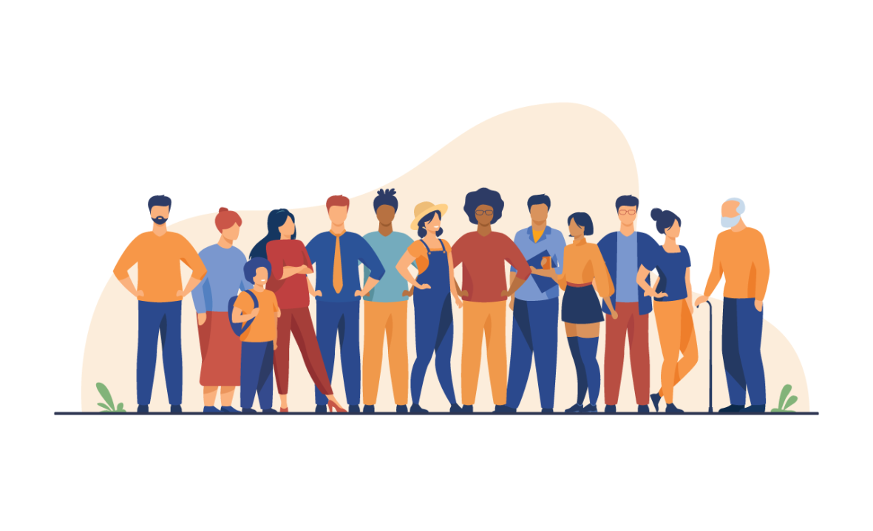
A design with inclusivity and neurodiversity in mind is not just ‘nice to have’ – it’s imperative

Slide 32
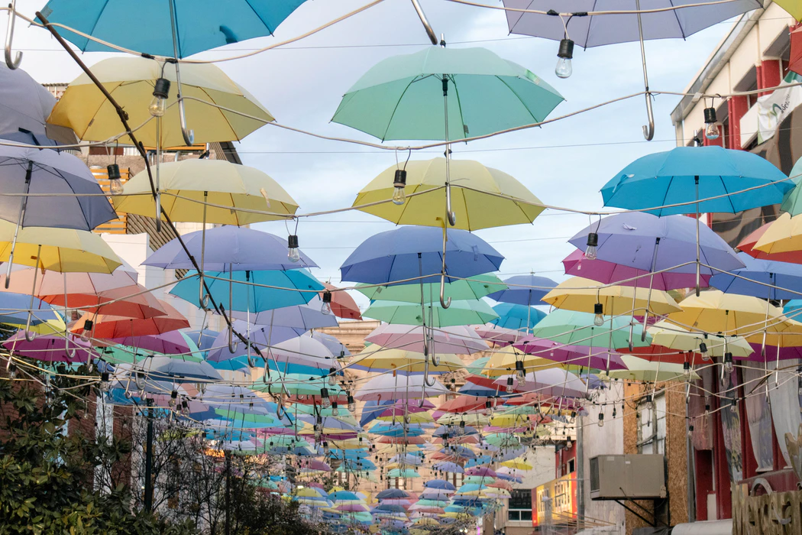

Slide 33
